Slide 1
Learning objectives
Identify and describe classmates and family members by identifying, speaking and writing physical and personality characteristics.

Slide 2
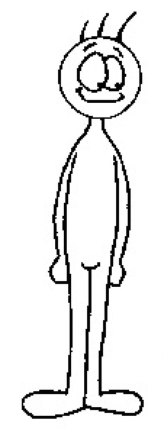
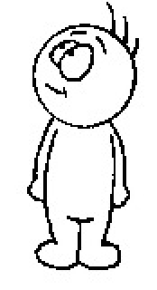
alto/a
bajo/a

Slide 3
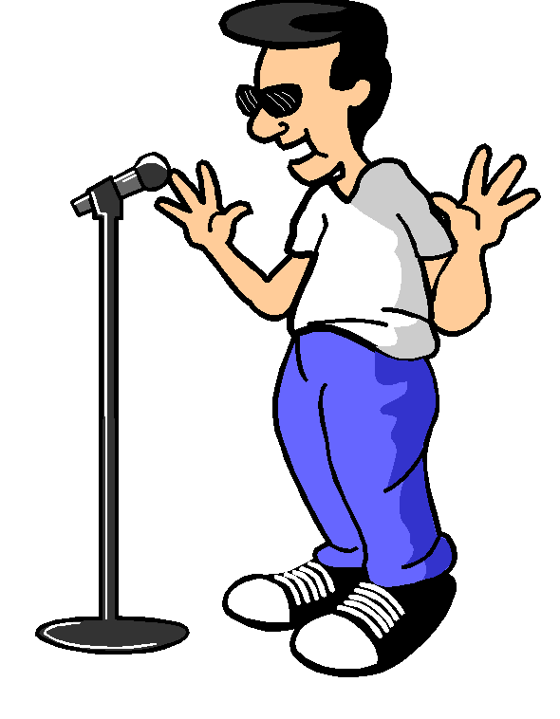
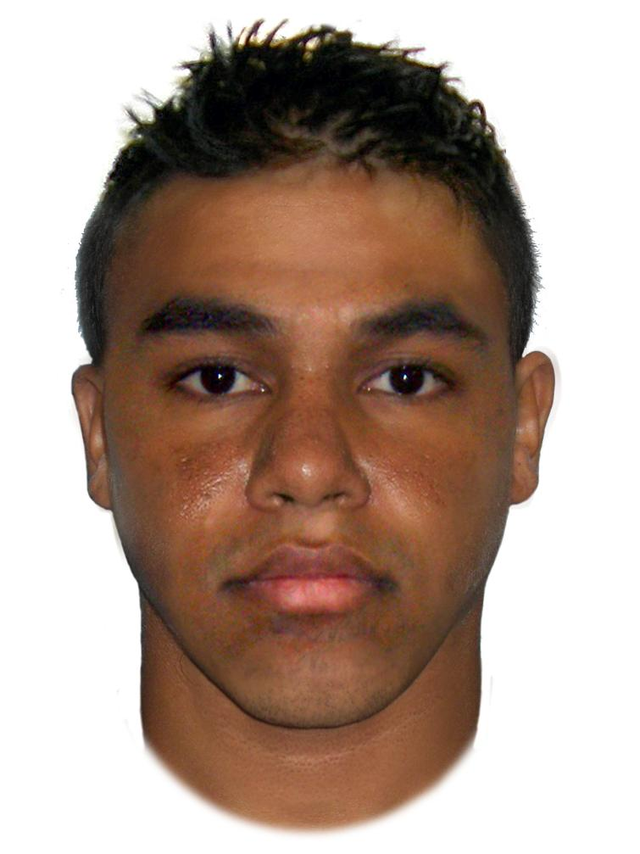
gracioso/a
serio/a

Slide 4
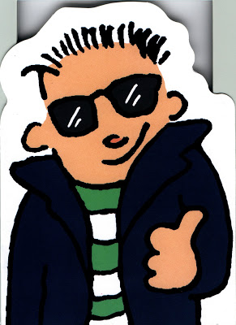

intelectual
fenomenal

Slide 5
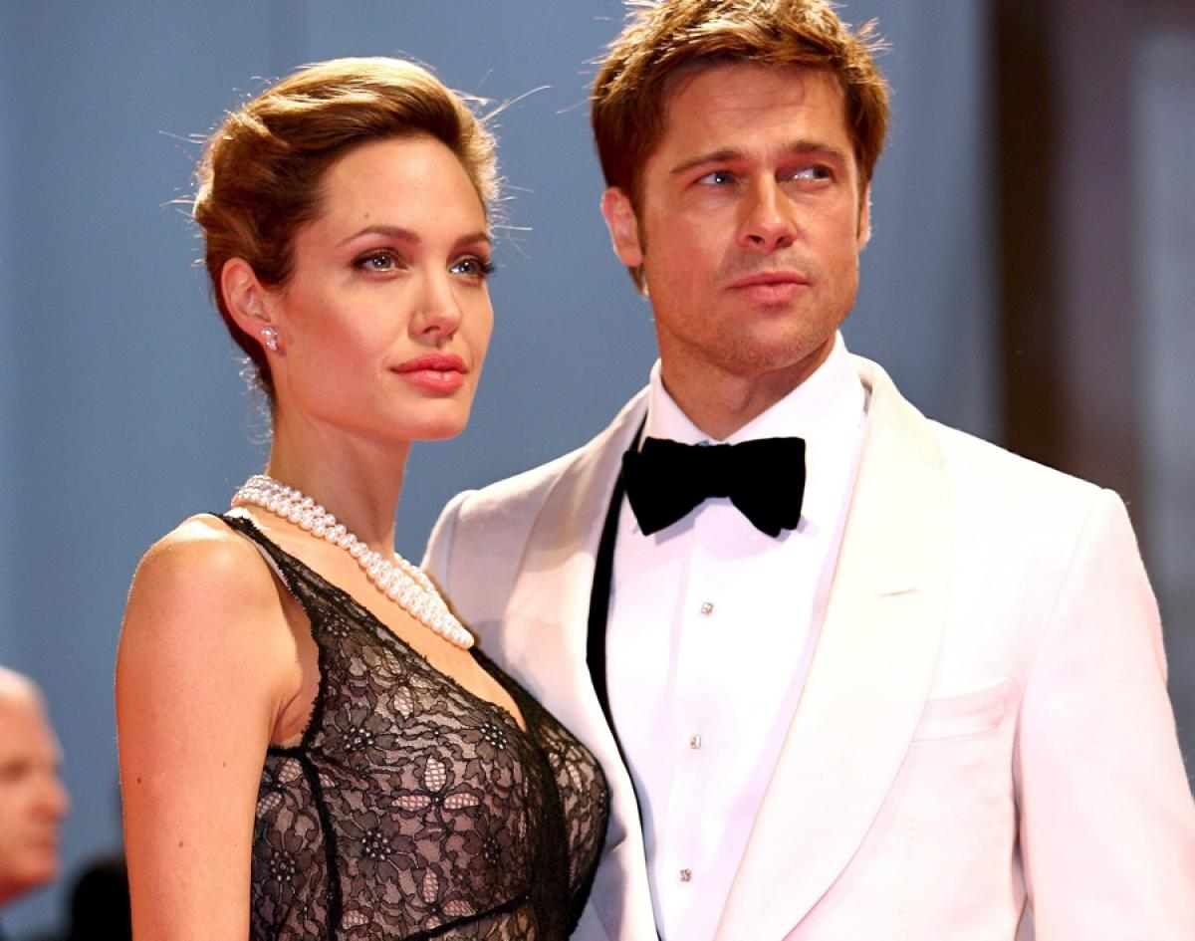
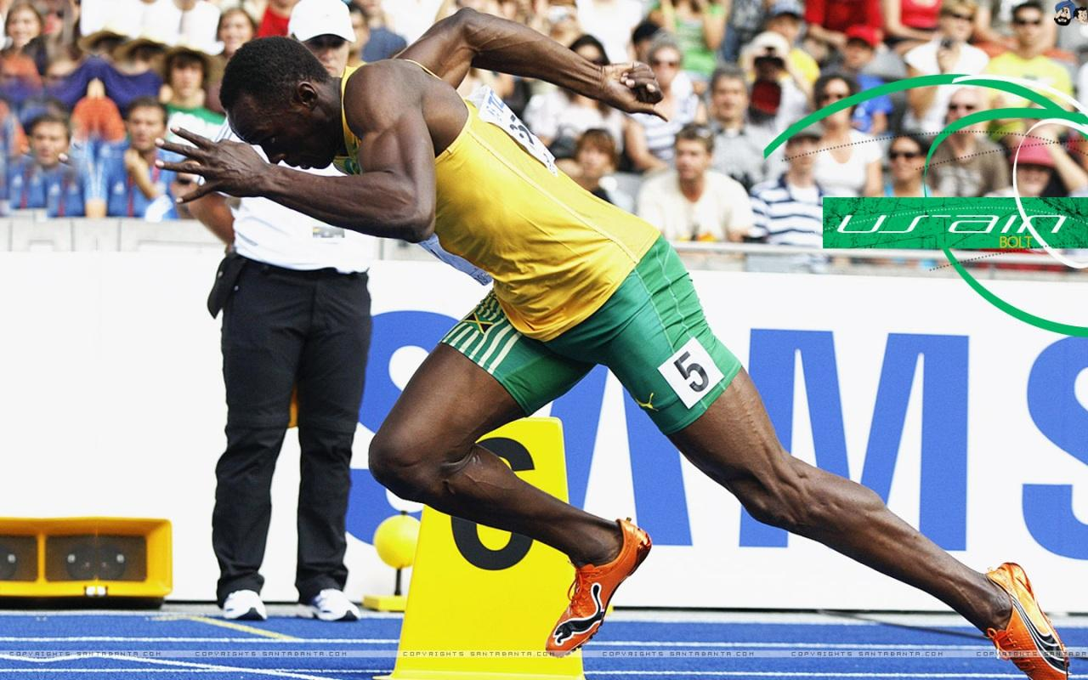
guapa y guapo
atlético(a)

Slide 6
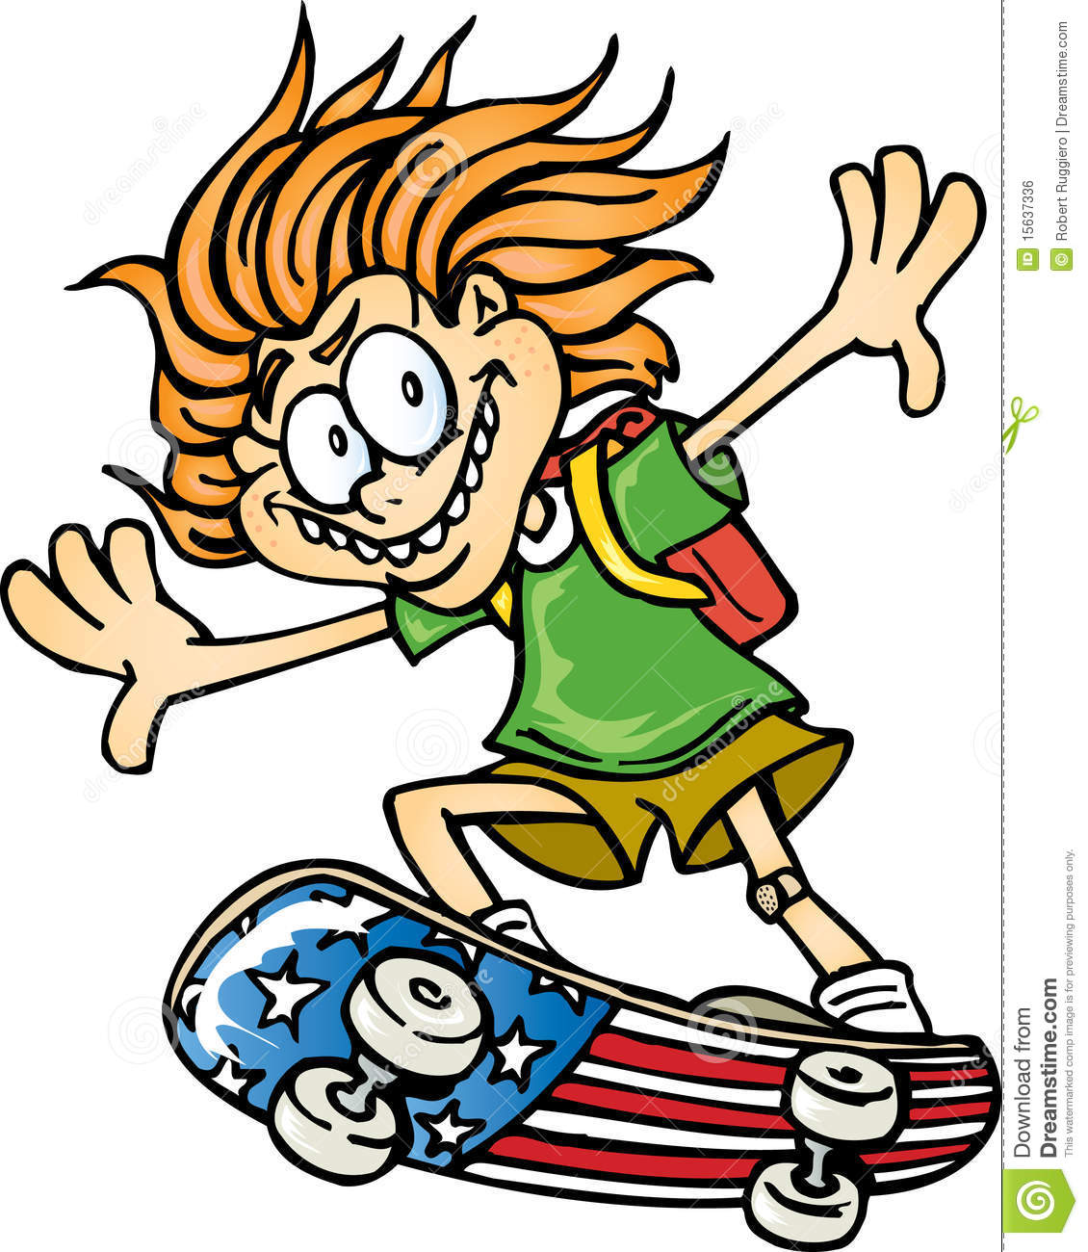

activo/a
reservado/a

Slide 7
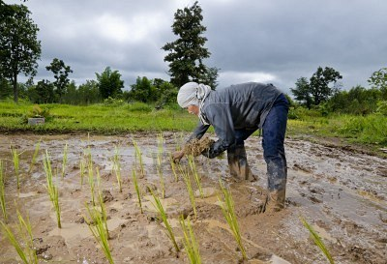
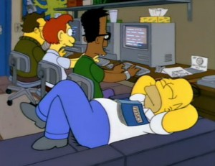
trabajador/a
perezoso/a

Slide 8

extrovertido/a
introvertido/a

Slide 9

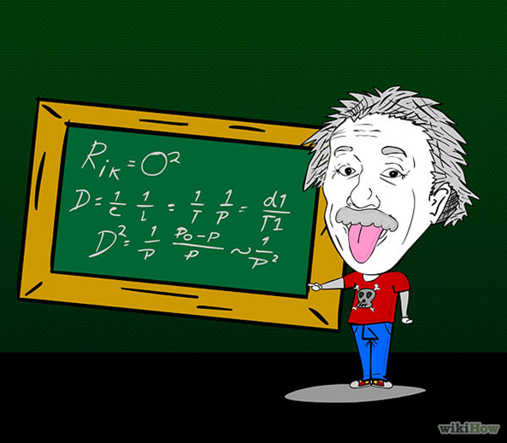
inteligente
elegante

Slide 10
VIDEO
“AGREE IT”

Slide 11

Describe yourself by writing a sentence with 3 adjectives.
You will be asked to read your sentence to the class.

Slide 12
